Slide 1

Plants vs Zombies
G26 Member :
Nguyễn Đình Minh Phúc - ITITUN17003

Slide 2

Class Diagram

Slide 3
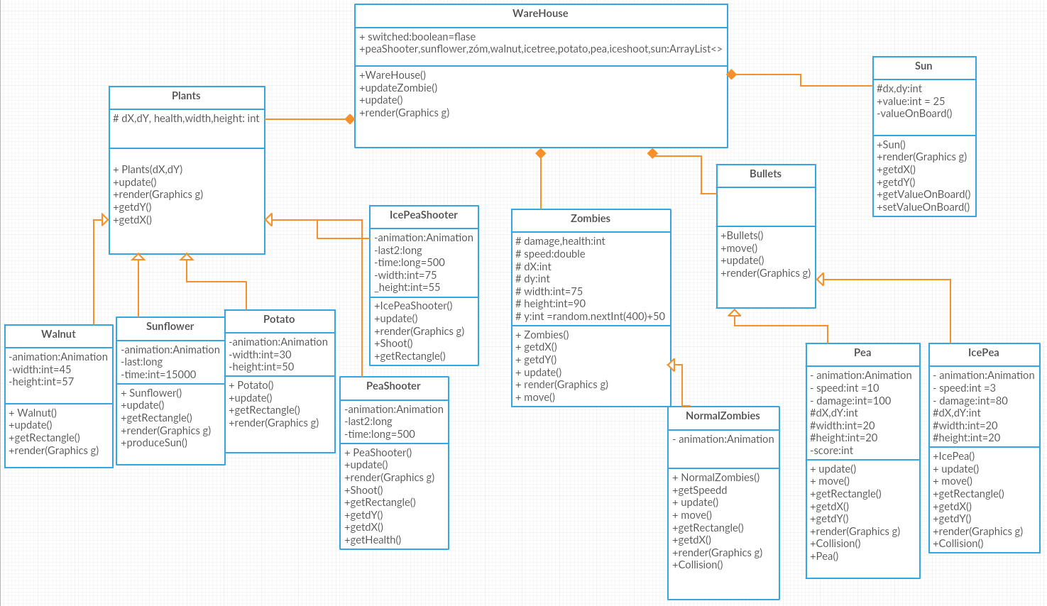
Characters

Slide 4
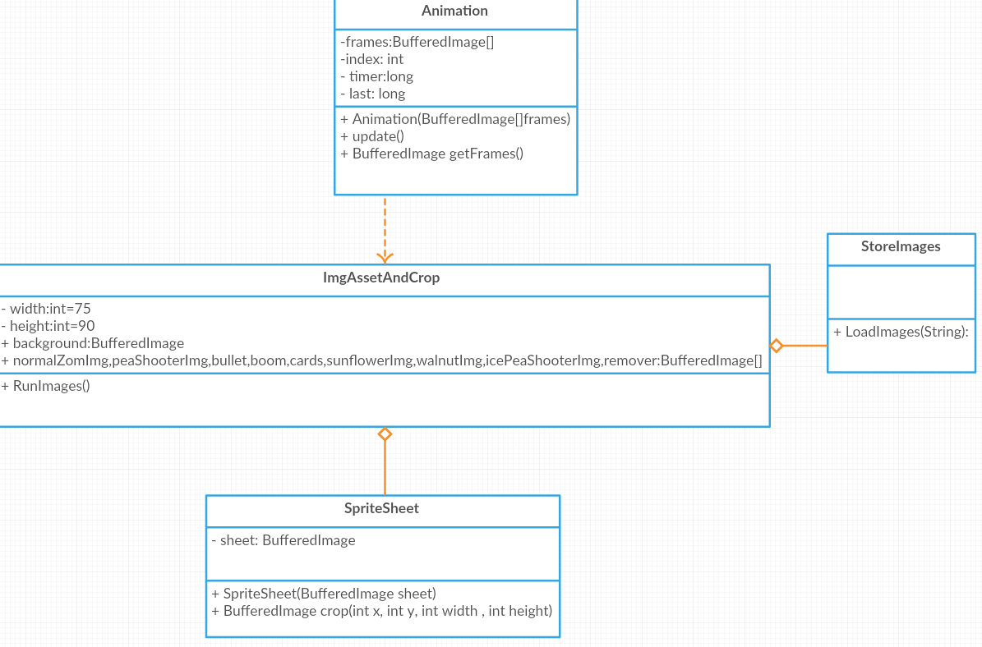
Graphic and Animation

Slide 5
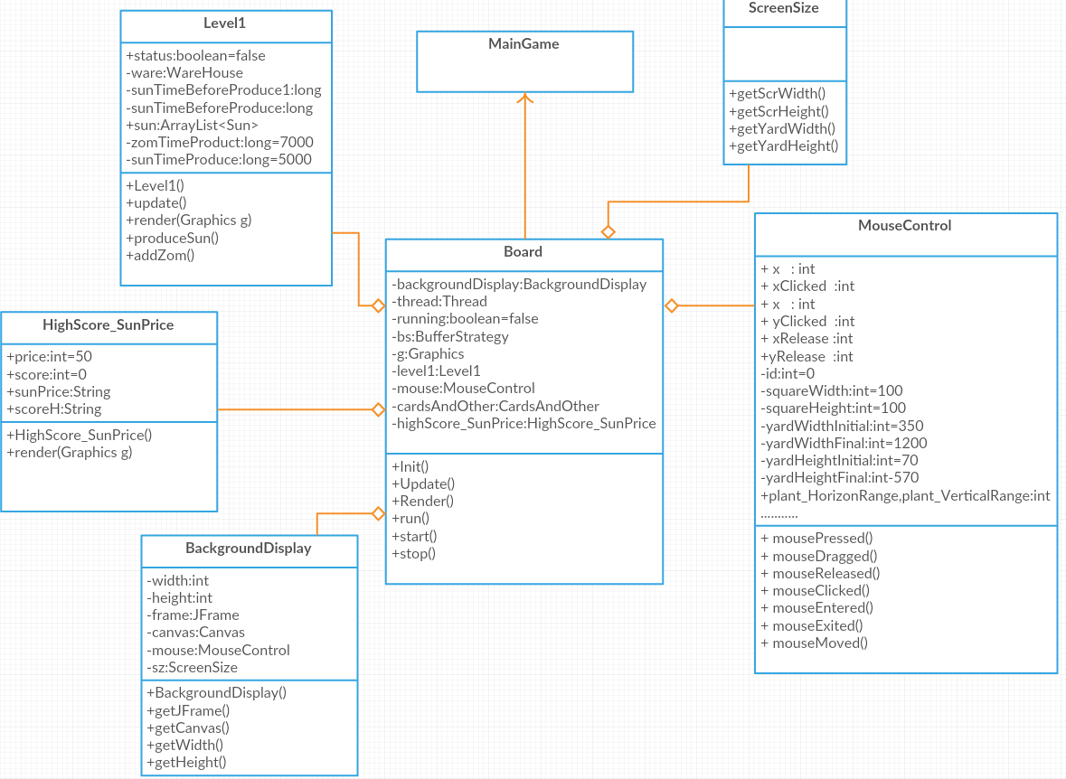
Game Board

Slide 6
Thank you for listening

